Slide 1
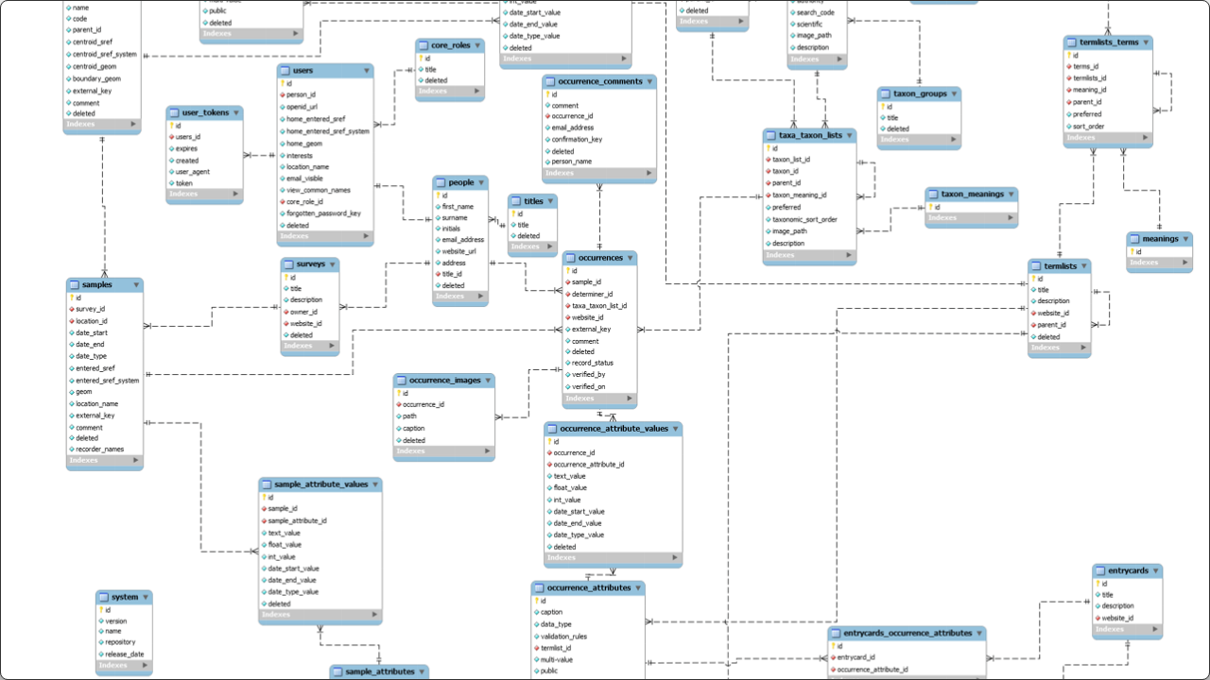

Grand Pearl Hotel
Backend Database Structure
Detailed Schema Analysis & Entity Relationships
Target System: SQL Server (T-SQL) | Modules: 7 | Tables: 60+

Slide 2







System Architecture Overview
Module 1
Module 2
Module 3
Guest & Room Management (Reservations, Check-ins)
Restaurant & POS (Orders, KOT, Menu)
HR & Payroll (Employees, Shifts, Salaries)
Module 4
Module 5
Module 6
Inventory (Procurement, Stock, Vendors)
Facilities (Spa, Gym, Events, Housekeeping)
Cybersecurity (Audit Logs, RBAC, Encryption)
Module 7
Marketing ( Feedback, Marketing)

Slide 3
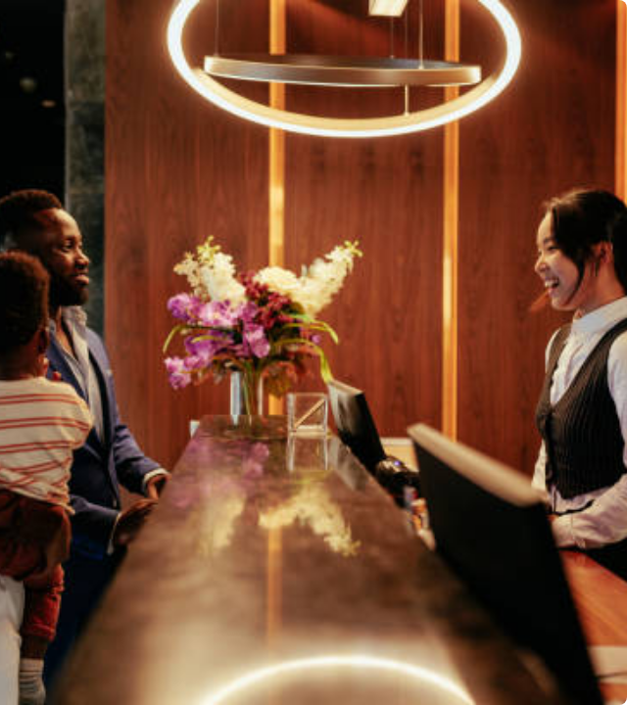
Module 1:
Guest & Room
Management
Core Focus: Managing the guest lifecycle from booking to checkout.
Key Relationships: One-to-Many link between Guests and Reservations. Many-to-Many link between Rooms and Amenities.

Slide 4
Schema: Rooms & Definitions
Table Name | PK | FK Targets | Description
Room_Types | TypeID | - | Defines class (e.g., Deluxe, Presidential), Base Price, Desc.
Rooms | RoomID | TypeID | Physical room inventory. Status (Available, Occupied).
Room_Amenities | AmenityID | - | List of features (WiFi, Jacuzzi, Sea View).
Room_Amenity_Mapping | Composite | RoomID, AmenityID | Junction table linking specific amenities to specific rooms.

Slide 5
Schema: Reservations & Guests
Table Name | PK | Foreign Keys | Key Columns
Guests | GuestID | - | FirstName, LastName, Email, Identity_No
Reservations | ResID | GuestID, RoomID | CheckInDate, CheckOutDate, Status
CheckIn_Records | CheckInID | ResID | ActualCheckIn, KeyCardNo (RFID)
CheckOut_Records | CheckOutID | CheckInID | ActualCheckOut, TotalBill
Blacklisted_Guests | BlacklistID | GuestID | Reason (Security Block)

Slide 6

Module 2:
Restaurant & POS
Core Focus: F&B operations across multiple outlets.
Key Relationships: Orders link Guests to Tables. Order Details link Orders to Menu Items.

Slide 7
Schema: Menu & Outlets
Table Name | PK | Foreign Keys | Description
Restaurant_Outlets | OutletID | - | Locations (e.g., Rooftop Bar, Main Dining).
Menu_Categories | CategoryID | - | Groups (Starters, Mains, Desserts).
Menu_Items | ItemID | CategoryID | ItemName, Price.
Menu_Discounts | DiscountID | ItemID | Percentage discount logic.
Restaurant_Tables | TableID | OutletID | TableNo, Capacity.

Slide 8
Schema: Orders & Transactions
Table Name | PK | Foreign Keys | Description
Orders | OrderID | TableID, GuestID | Links guest to a table session. OrderTime.
Order_Details | DetailID | OrderID, ItemID | Specific items ordered and Quantity.
Kitchen_Tickets | KOT_ID | OrderID | Tracks cooking status (Pending/Completed).
Restaurant_Payments | PayID | OrderID | Amount, PaymentMode (Cash/Card/Room).

Slide 9

Module 3:
HR & Payroll
Core Focus: Workforce management, attendance, and compensation.
Key Relationships: Employees belong to Departments and hold Designations.

Slide 10
Schema: Organizational Structure
Table Name | PK | Foreign Keys | Description
Departments | DeptID | - | Operational units (IT, Kitchen, HR).
Designations | DesigID | - | Job Titles (Manager, Chef, Janitor).
Employees | EmpID | DeptID, DesigID | Core staff record. Salary, FullName.
Shifts | ShiftID | - | Time definitions (Morning, Night Audit).

Slide 11
Schema: Attendance & Payroll
Table Name | PK | Foreign Keys | Key Columns
Attendance | AttID | EmpID | Date, Status (Present/Absent).
Salary_Slips | SlipID | EmpID | Month, NetPay (Calculated).
Leave_Records | LeaveID | EmpID | LeaveType, Status (Approved/Rejected).
Employee_Documents | DocID | EmpID | DocType (Passport/CNIC).

Slide 12

Module 4:
Inventory
Core Focus: Procurement chain and stock level monitoring.
Key Relationships: Purchase Orders linked to Vendors. Inventory linked to Stock Items.

Slide 13
Schema: Stock Definitions
Table Name | PK | Foreign Keys | Description
Inventory_Cats | InvCatID | - | Categories (Food, Linen, Electronics).
Stock_Items | StockID | InvCatID | Item Definition, MinQty (Threshold).
Current_Inventory | InvID | StockID | Live Quantity on hand.
Stock_Issues | IssueID | StockID, DeptID | Items issued to internal depts.

Slide 14
Schema: Procurement Cycle
Table Name | PK | FKs | Workflow Stage
Vendors | VendorID | - | Supplier Master Data.
Purchase_Orders | PO_ID | VendorID | 1. Order Creation.
PO_Details | PODetailID | PO_ID, StockID | 2. Line Items Added.
Goods_Received | GRN_ID | PO_ID | 3. Delivery Confirmation.

Slide 15

Module 5:
Facilities
Core Focus: Managing Spa, Gym, Events, and Housekeeping.
Key Relationships: Bookings linked to Guests and specific Services/Halls.

Slide 16
Schema: Spa, Gym & Events
Table Name | PK | Foreign Keys | Description
Spa_Services | SpaID | - | Service Menu & Price.
Spa_Bookings | SpaBookID | GuestID, SpaID | Appointment scheduling.
Gym_Memberships | GymID | GuestID | Membership Plans.
Event_Halls | HallID | - | Banquet Hall capacities.
Hall_Bookings | HallBookID | HallID, GuestID | Event reservations.

Slide 17
Schema: Housekeeping & Laundry
Table Name | PK | Foreign Keys | Description
Laundry_Items | LaundryID | - | Price list (Shirt, Suit, etc).
Laundry_Orders | LOrderID | GuestID | Service request tracking.
Housekeeping_Tasks | TaskID | RoomID, EmpID | Cleaning assignments & Status.
Lost_Found | LF_ID | - | Found items logging.

Slide 18

Module 6:
Cybersecurity
Core Focus: Zero Trust Architecture, AAA (Auth, Authz, Accounting).
Key Relationships: Users linked to Roles. Logs linked to Users.

Slide 19
Schema: Authentication & Roles
Table Name | PK | Foreign Keys | Security Purpose
User_Roles_Security | SecRoleID | - | Defines Roles (Admin, User).
System_Users | UserID | EmpID, RoleID | Credentials (Hash), Auth.
User_Permissions | PermID | RoleID | Granular Access Control.
Session_Tokens | SessionID | UserID | Active Session Management.

Slide 20
Schema: Auditing & Monitoring
Table Name | PK | FKs | Description
Audit_Logs | LogID | UserID | Tracks Action, TableAffected, Time.
Failed_Logins | AttemptID | - | Intrusion Detection (IP, Time).
Password_History | PassHistID | UserID | Prevents password reuse.
IP_Whitelist | WhitelistID | - | Network Access Control.

Slide 21

Module 7: Marketing Schema
Table Name | PK | FKs
Guest_Feedback | FeedbackID | GuestID
Promotions_Marketing | PromoID | -
Feedback: Collects Ratings (1-5) & Comments.
Promotions: Manages Discount Codes and Date Ranges.

Slide 22
Questions?
Detailed Schema Review Complete
Grand Pearl Hotel Database Architecture

